Slide 1
Meeting 13
Wednesday 16/05/2018

Slide 2
Agenda
Timeline + the next big steps
Comparison wakes: Fuga – LES
Single wake
Full wake
LES superposition
Fuga superposition
Single wake calibration: LES - Park

Slide 3
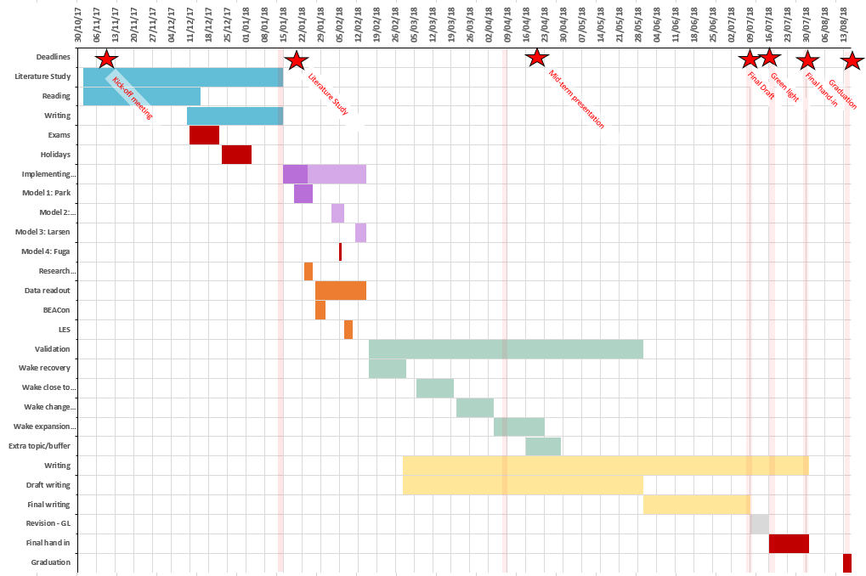
1. Timeline
Final draft: 09/07/2018
Green light:
16/07/2018
Final hand-in
31/07/2018
Defence/Graduation:
13-16/08/2018
(ok for Carlos? 15/08 holiday?)

Slide 4
1. The big next steps
Single wake superposition
LES
Fuga
Comparison
Datasets
BEACon
LES: full wake + LES superposition
Park
Fuga: full wake + Fuga superposition
Focus on
Horizontal profiles + maximum deficit
Wake boundary
Wake recovery (streamwise line + rotor averaged)
Case 2: wake change upstream
 | Case 1 | Case 2 | Case 3 | Case* 14 m/s | Case* 11,2 m/s
BEACon | X | X
LES | X |  | (X) | X | X
Park | X | X | X | X | X
Fuga | X | X | X | X | X
Case*: with NM80 wind turbine
(X): old inflow profile
Notes:
Case*: with NM80 wind turbine
(X): old inflow profile

Slide 5
1. The big next steps
Conclusions
Comparison
Is superposition the bottle neck or the uncertainties in the data?
Writing (continuously) Update literature study/midterm report

Slide 6
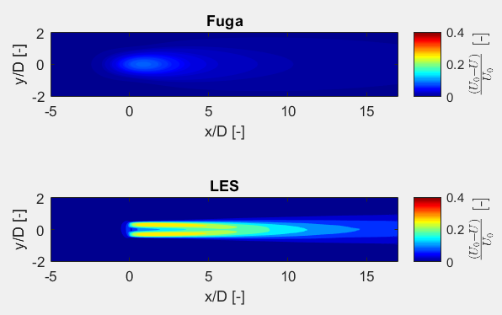
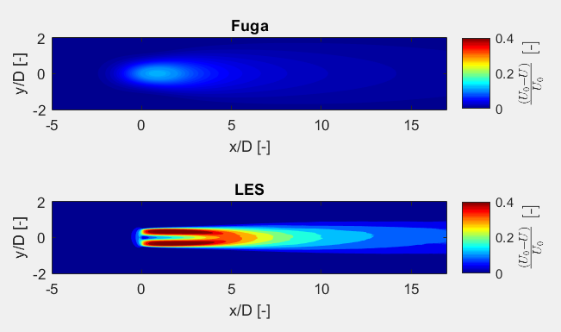
2a. Comparison single wakes: Fuga - LES
U0=14 m/s U0=11,16 m/s

Slide 7
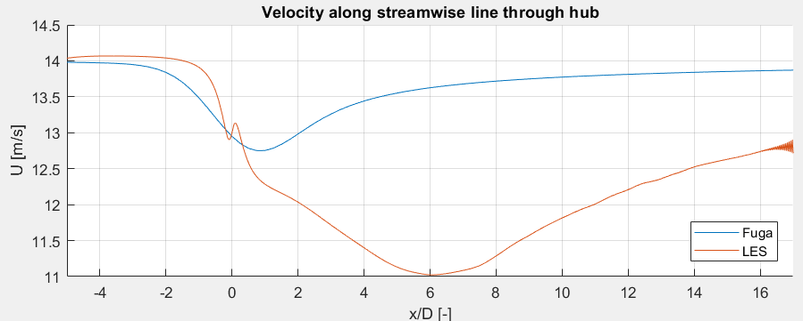
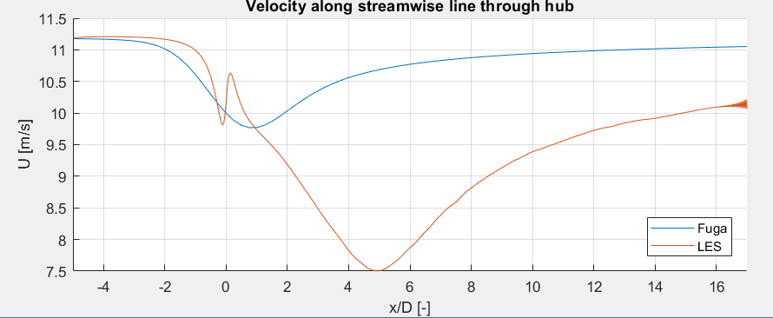
U0=14 m/s
U0=11,16 m/s

Slide 8
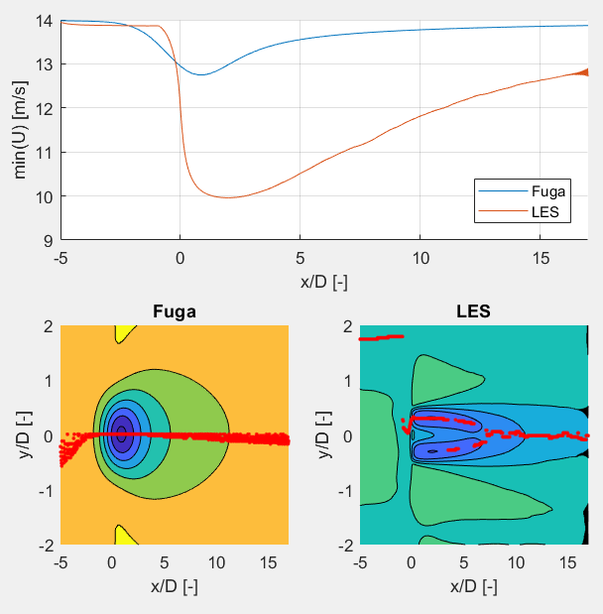
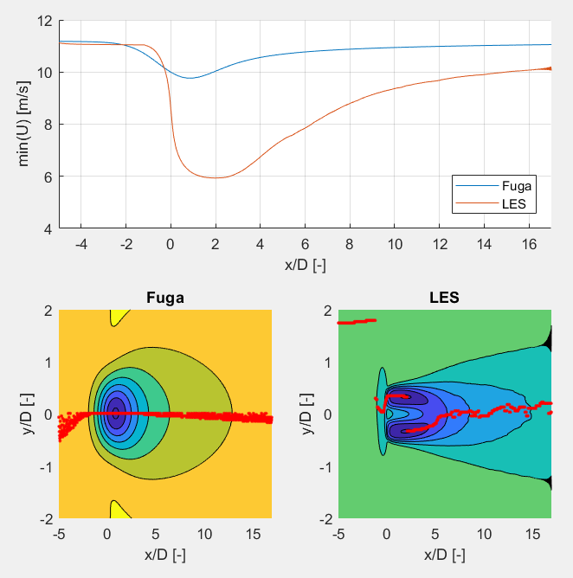
U0=14 m/s U0=11,16 m/s

Slide 9
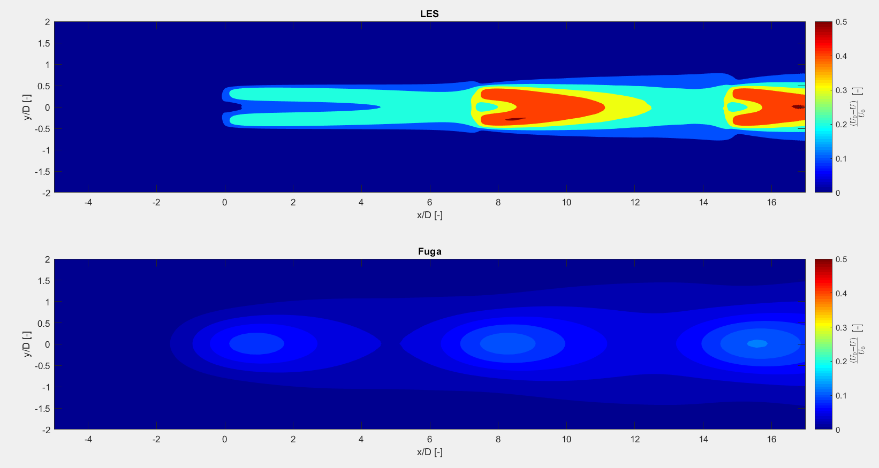
2b. Comparison full wakes: Fuga - LES
U0=14 m/s

Slide 10
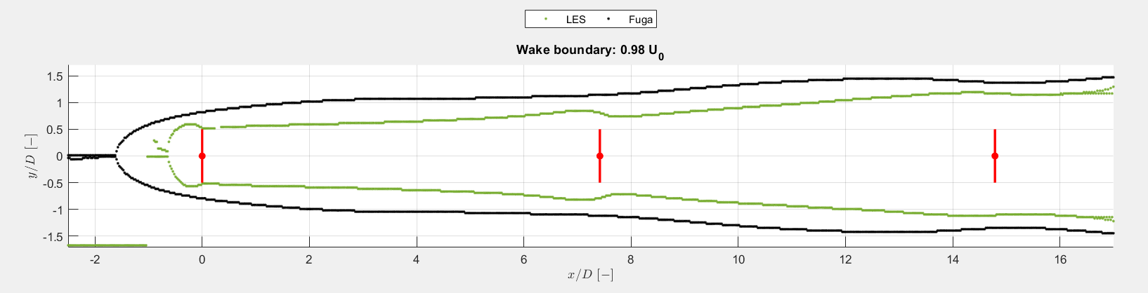
2b. Comparison full wakes: Fuga - LES

Slide 11
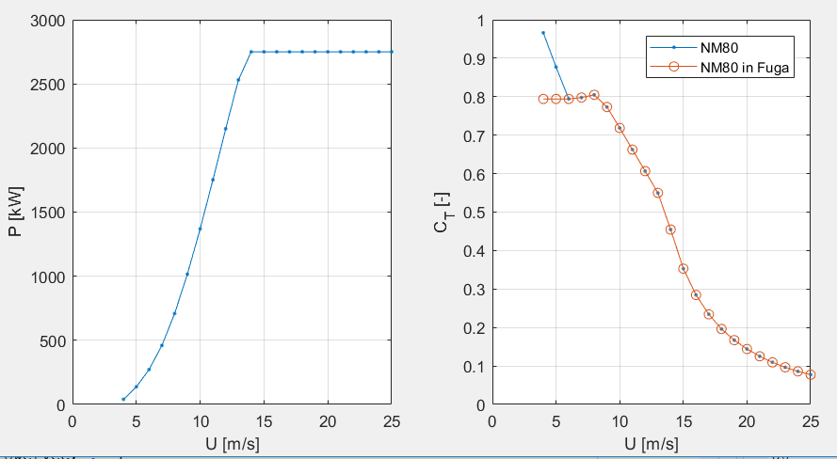
3. LES superposition
U0=14 m/s
No shear, no vear
TI=4%
NM80
No hub height (floating wind turbine rotor)
3 single wakes, “full wake” with 3 WT

Slide 12
3. LES superposition
Wake 1: single wake with U0=14 m/s
Define horizontal wind speed at hub height at location of second wind turbine in wake 1 (U=11,16 m/s)
Wake 2: single wake with U0=11,16 m/s
Define horizontal wind speed at hub height at location of third wind turbine in wake 2 (U=8,54 m/s)
Wake 3: single wake with U0=8,54 m/s (or scaled version)
 | Wake 1 | Wake 2 | Wake 3
U0 | 14 m/s | 11,16 m/s | 8,54 m/s
U0 | 11,16 m/s | 8,55 m/s | … m/s

Slide 13
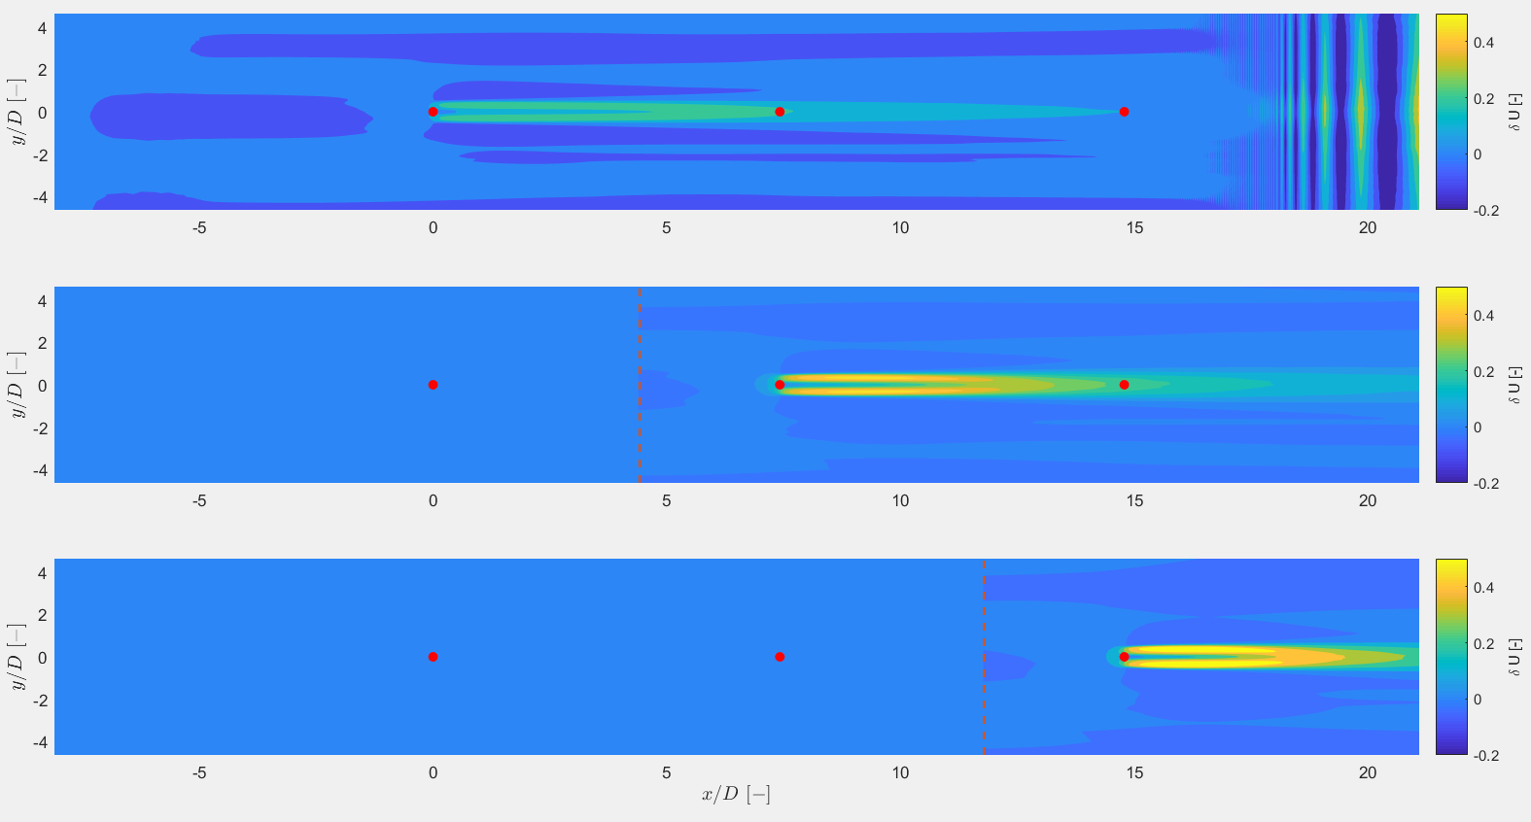
3. LES superposition

Slide 14
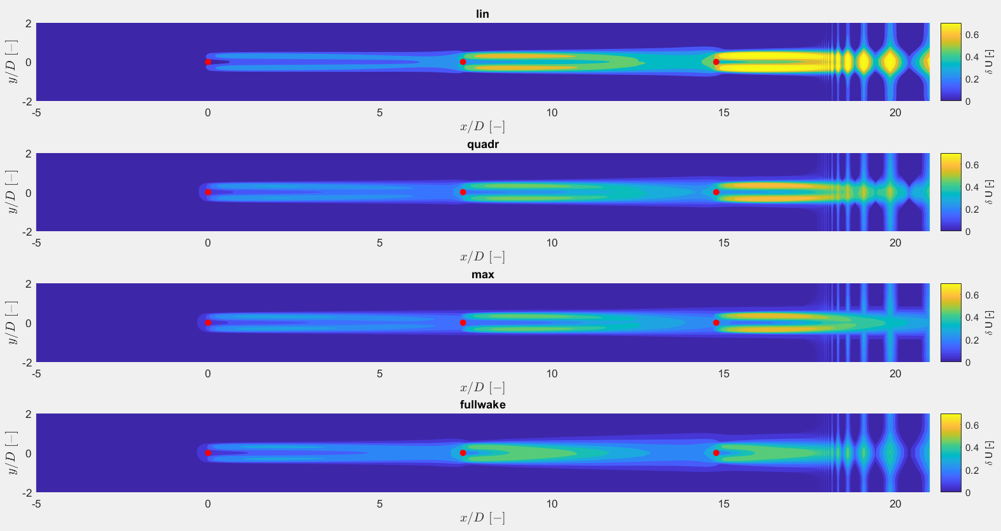
3. LES superposition

Slide 15
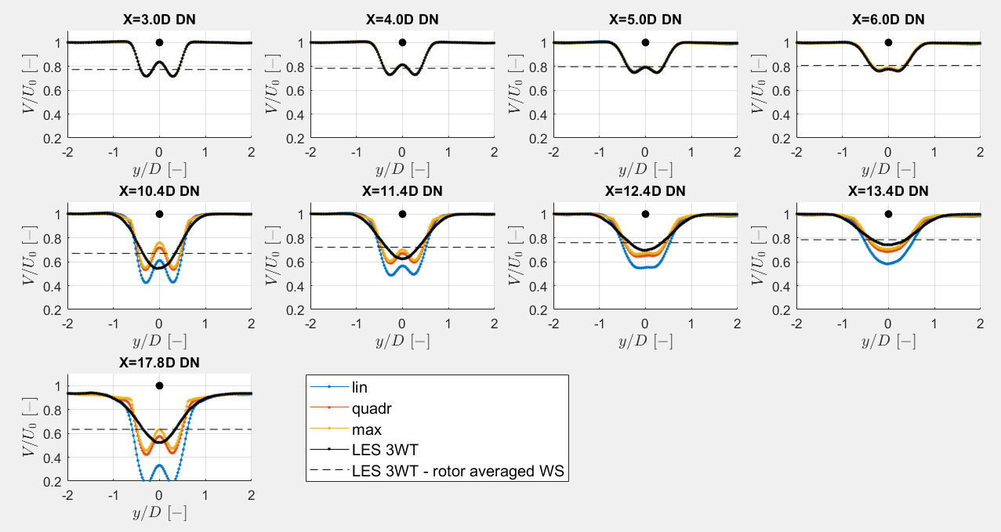
3. LES superposition

Slide 16
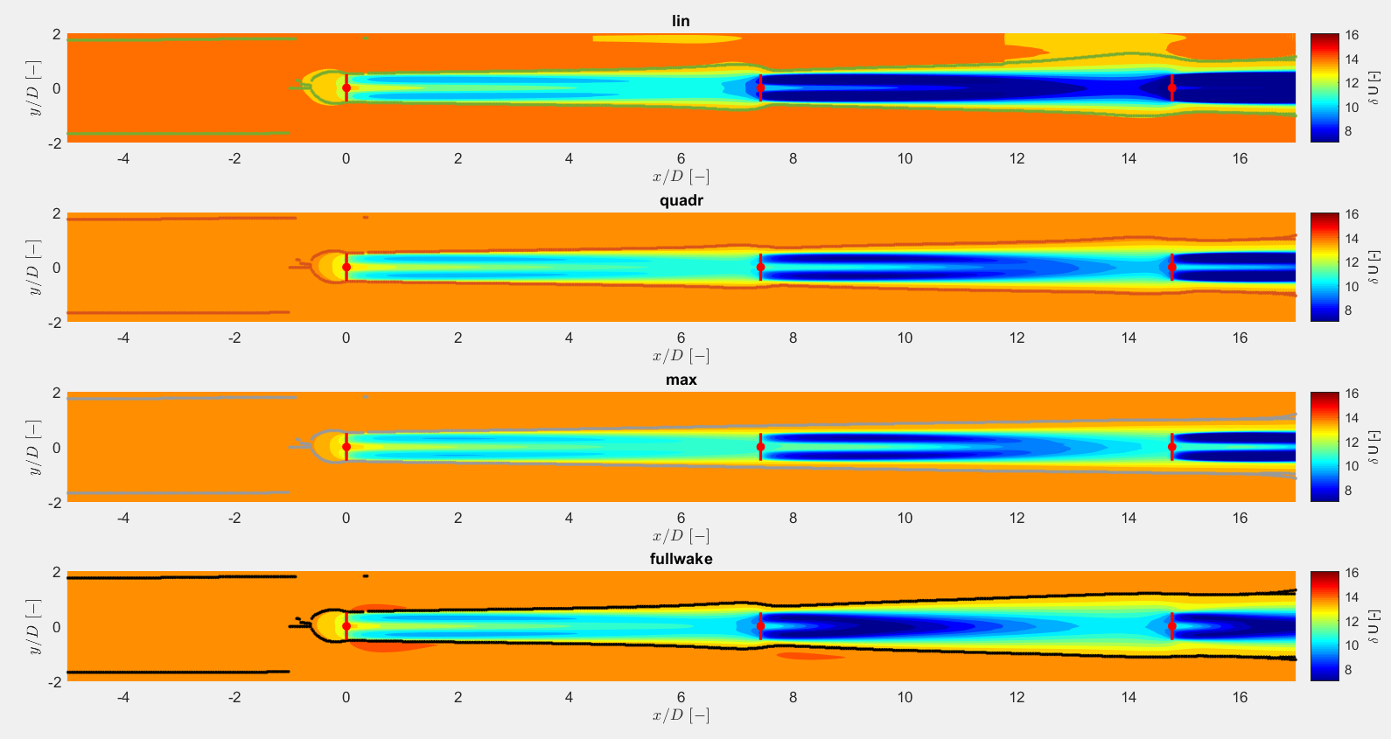
3. LES superposition – wake width
Wake boundary at 0,98*U0

Slide 17
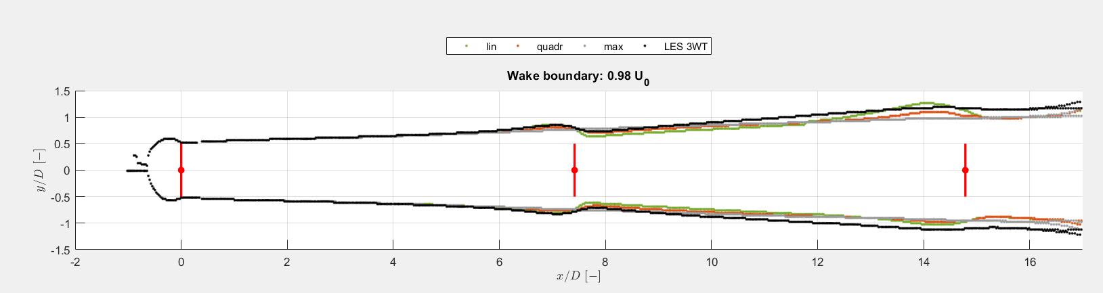
3. LES superposition

Slide 18
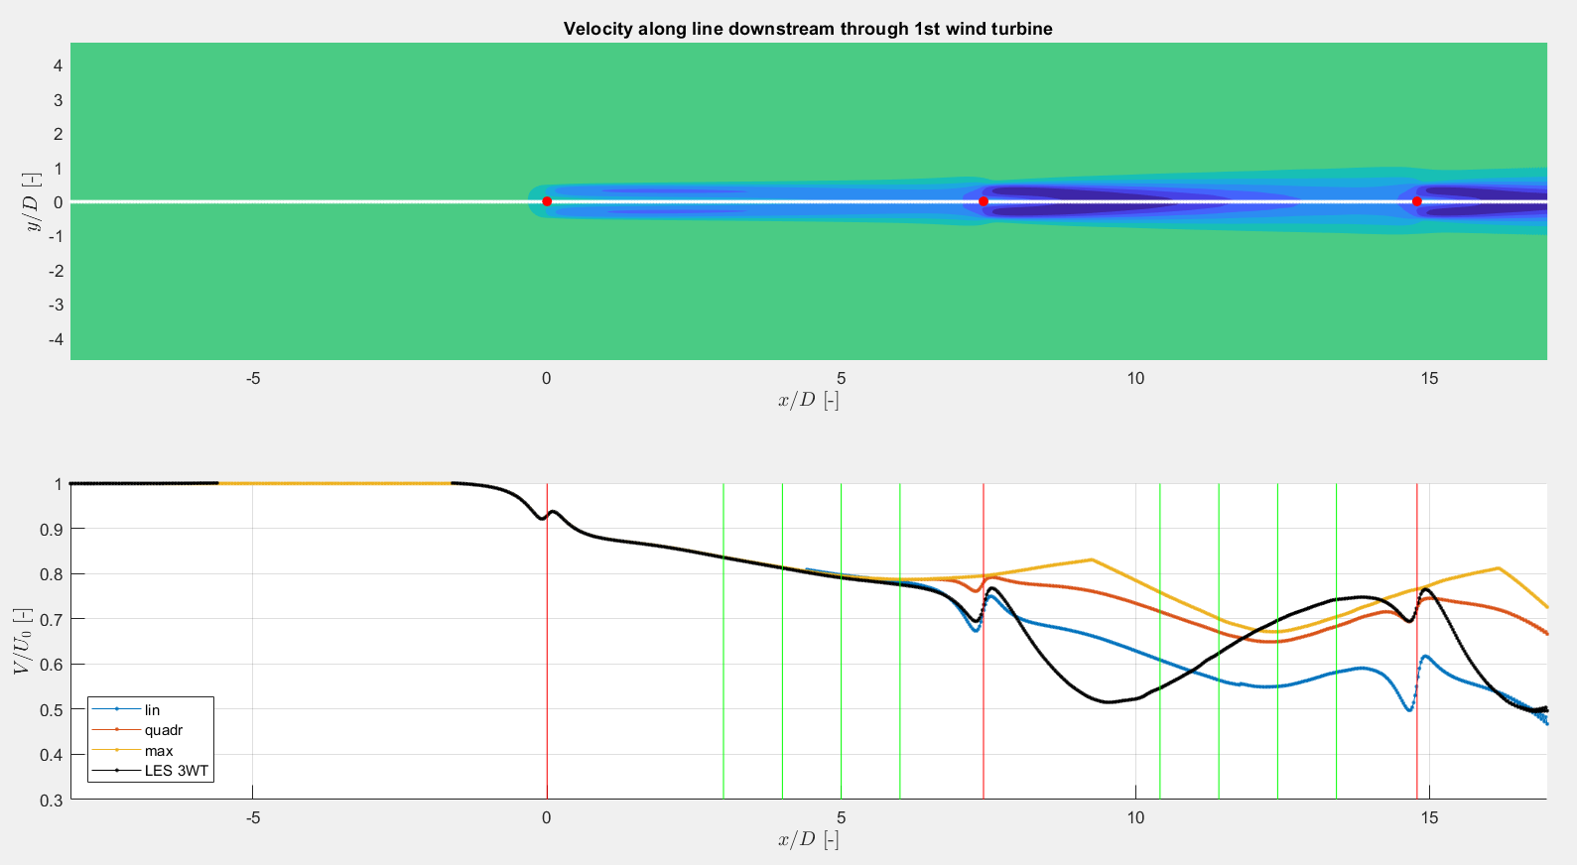
3. LES superposition

Slide 19
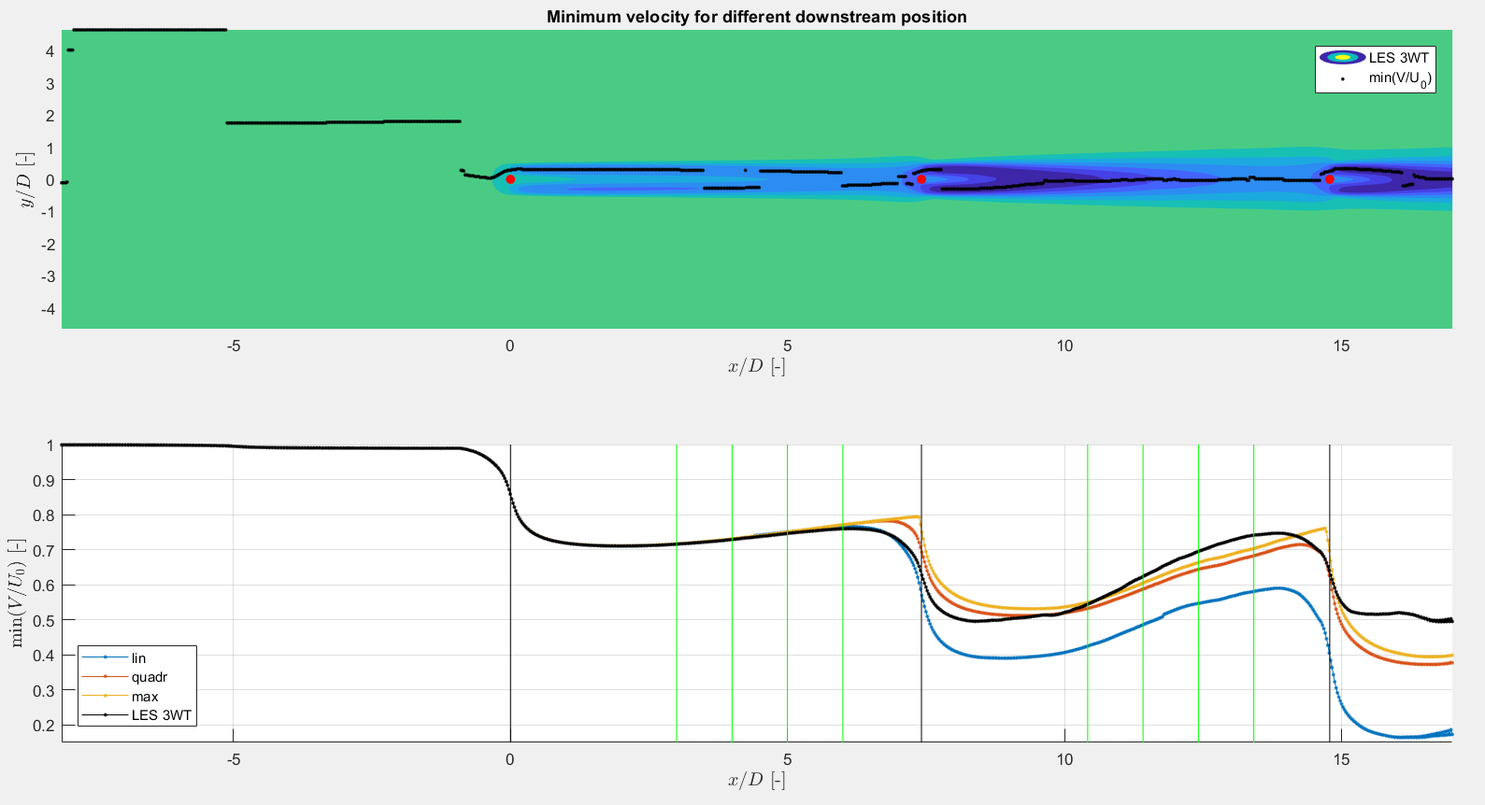
3. LES Superposition

Slide 20
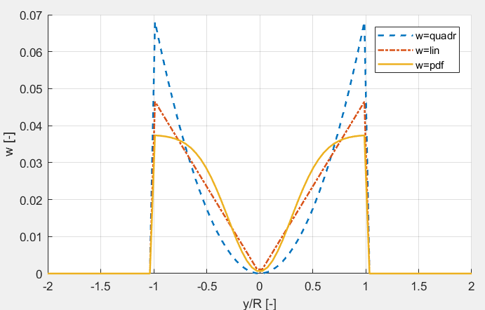
3. LES superposition: Rotor averaged wind speed
Not possible to superpose the vertical planes due to the saved positions of the vertical planes
Weighting function used to calculate the rotor averaged wind speed, making use of the horizontal profiles
Full 3WT LES simulation
Horizontal profile + weighting function
Rotor averaged wind speed in vertical plane
→ Linear weighting function

Slide 21
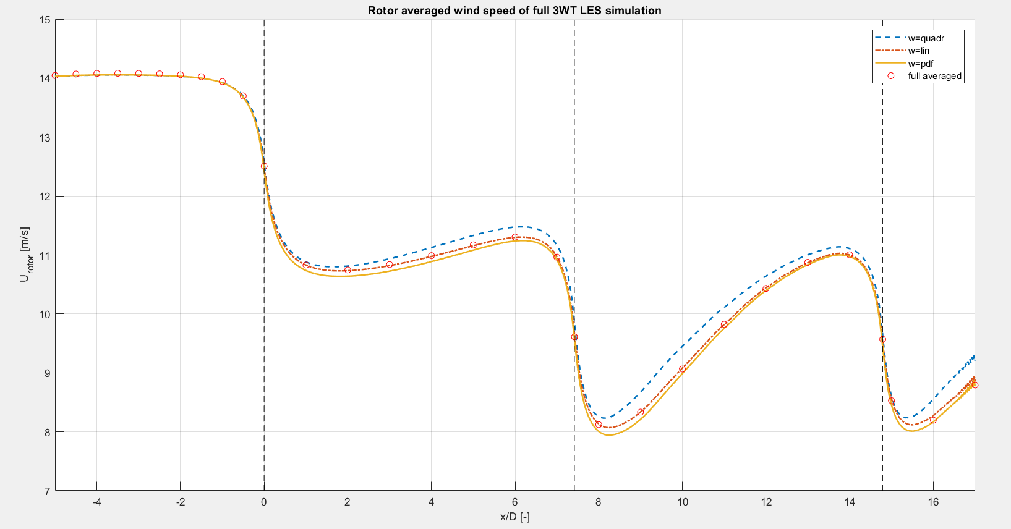
3. LES superposition: Rotor averaged wind speed

Slide 22
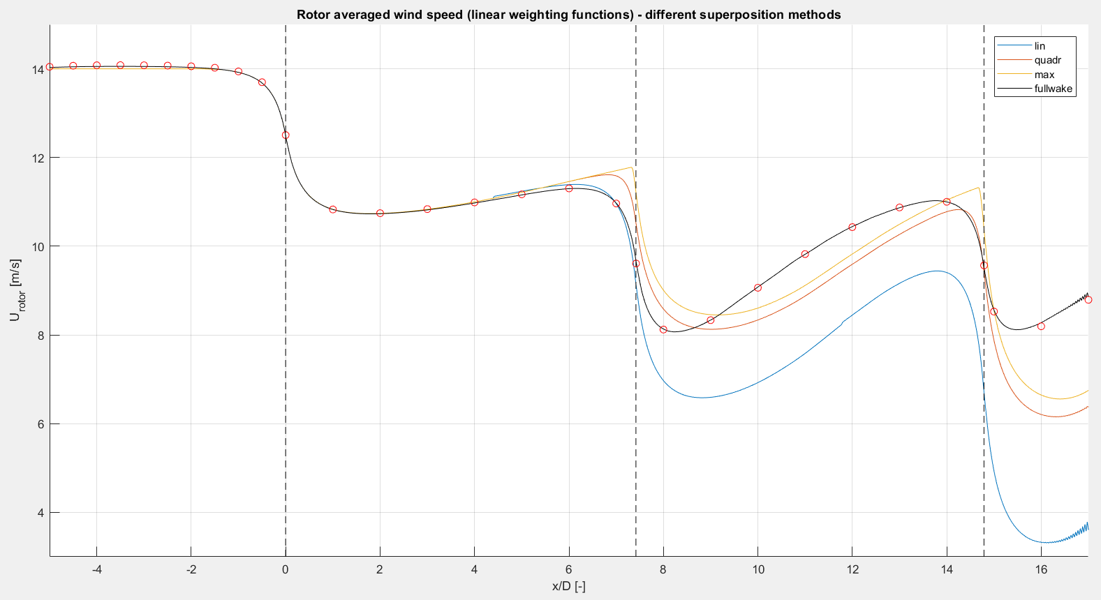
3. LES superposition: Rotor averaged wind speed

Slide 23
4. Fuga superposition
Same method used as LES superposition
NM80, but CT curve slightly changed
Hub height at 200m + unstable inflow profile → very low shear
 | Wake 1 | Wake 2 | Wake 3
U0 | 14 m/s | 13,70 m/s | 13,38 m/s
U0 | 11,16 m/s | 10,85 m/s | 10,55 m/s

Slide 24
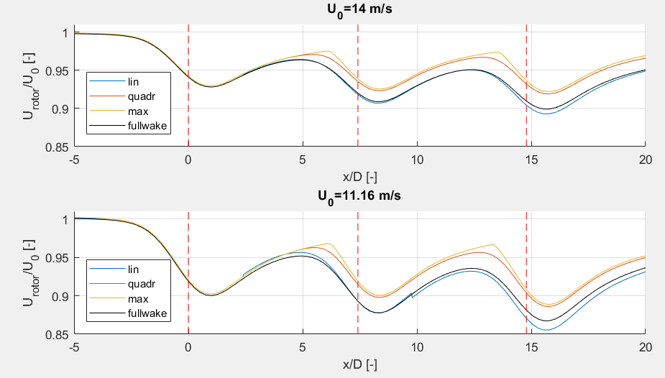
4. Fuga superposition
Difference between linear superposition and full wake
Probably (linearly) superposed wind speed of wake 1 and wake 2 taken as inflow wind speed for wake 3

Slide 25
5. Single wake calibration: LES - Park
Calibrate the single Park wake with the single LES wake
Wake expansion coefficient k
Based on
Wake width
Rotor averaged wind speed
Variables that remain → 12 possibilities
Superposition method: linear, quadratic or max deficit
Correction factor: true or false
Wake reflection: true or false

Slide 26
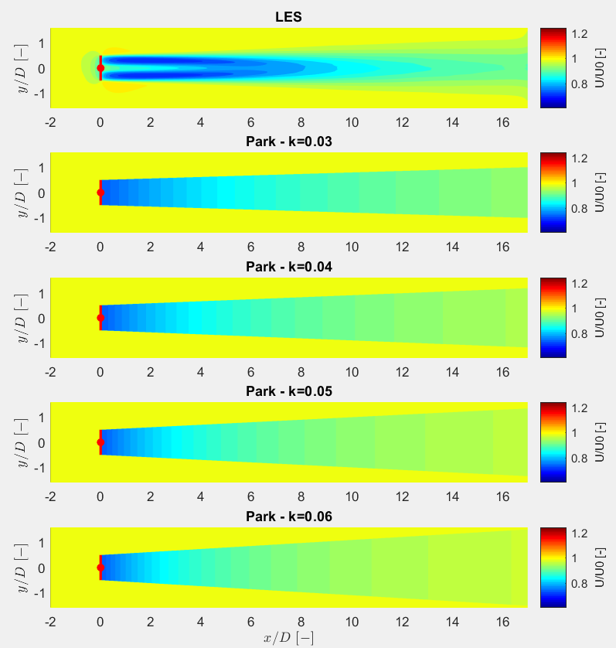
U0=14 m/s

Slide 27
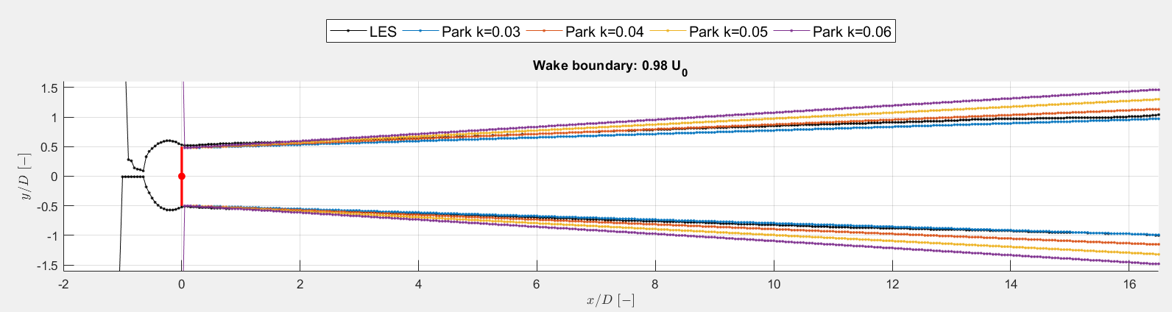
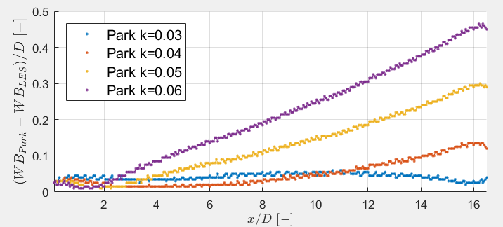
5. Single wake calibration: LES - Park
U0=14 m/s

Slide 28
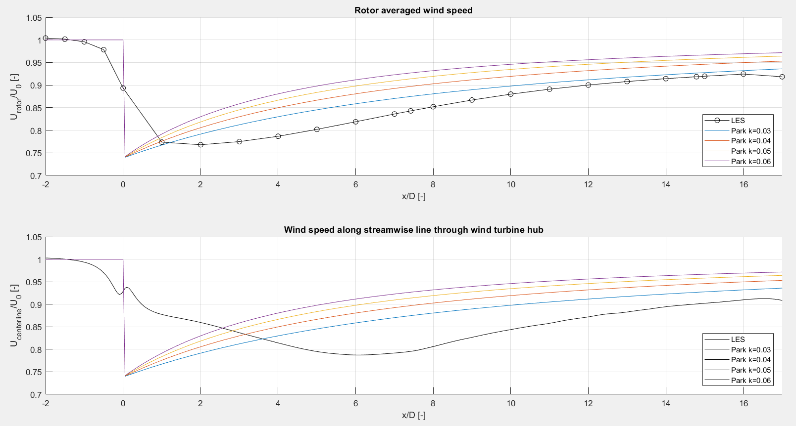
5. Single wake calibration: LES - Park
U0=14 m/s

Slide 29
Next steps
Calibrate single Park wake with BEACon (if possible?)
Compare full fields
Park – LES – Fuga (with NM80 wind turbine)
Park – BEACon – Fuga (with WMR wind turbine)
Can LES superposition be improved?
Scaling factor?
Different inflow wind speed?

